Slide 1

Spring 2022
random variables & their probability distributions
Programming and Data Analysis for Modern Neuroscience
NEU 365P/385L
Marcel Goldschen-ohm
Assistant Professor in the Department of Neuroscience, The University of Texas at Austin

Slide 2

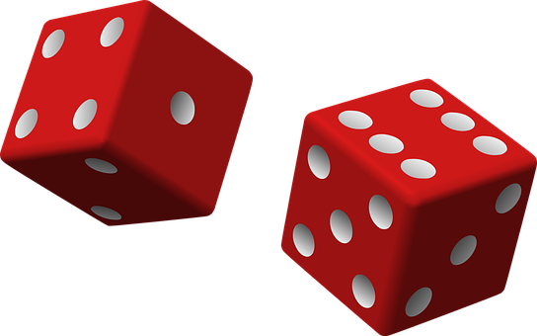
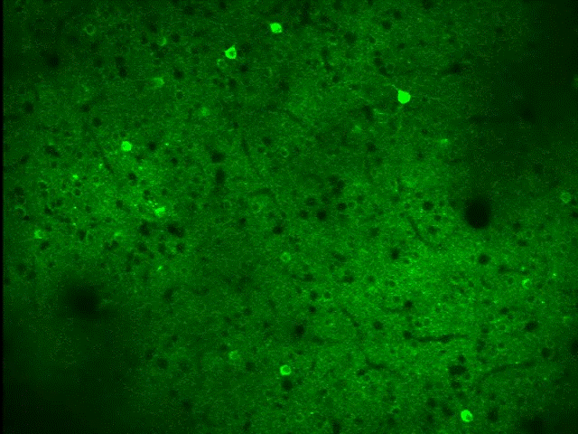
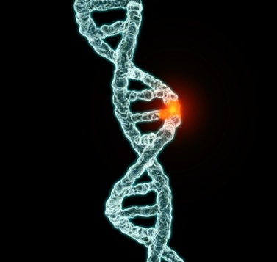

Random Variables

Slide 3

Learning goals – Probability density
You will understand the difference between a probability and a probability density.

Slide 4
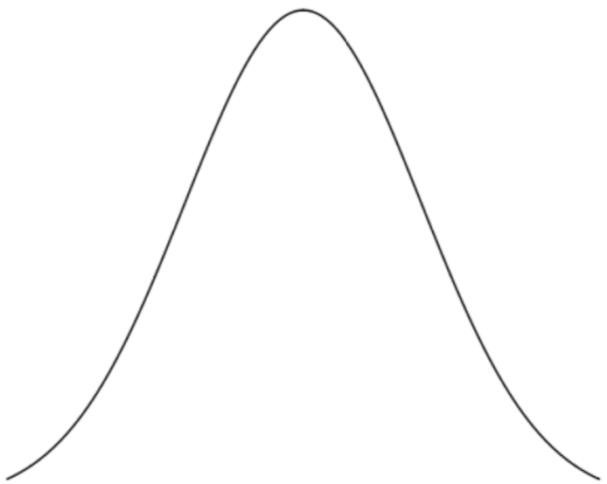
Discrete & Continuous Random Variables
Probability Density
Function (PDF)
Probability
X=A
X=B
X=C
X=D
X
e.g. Tomorrow’s Weather Type
e.g. Tomorrow’s Temperature

Slide 5
Discrete & Continuous Random Variables
Probability Density
Function (PDF)
Probability
X=A
X=B
X=C
X=D
X
e.g. Counting:
How many cells/spikes?
e.g. Classification:
Which cell type?
e.g. Measurement:
Membrane Voltage,
Synapse Volume,
Ca²⁺ Concentration, etc.

Slide 6
Probability Mass = Probability
Probability Mass
Function (PMF)
Probability Density
Function (PDF)
X=A
X=B
X=C
X=D
X
e.g. Counting:
How many cells/spikes?
e.g. Classification:
Which cell type?
e.g. Measurement:
Membrane Voltage,
Synapse Volume,
Ca²⁺ Concentration, etc.

Slide 7
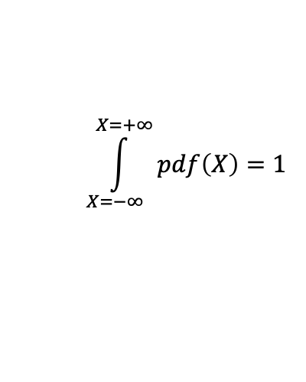
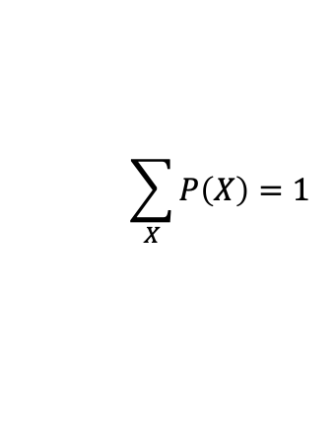
Sum of all possible probabilities = 1
Probability Density
Function (PDF)
Probability
X=A
X=B
X=C
X=D
X
$$\sum_{X}{P\left(X\right)}=1$$
$$\int_{X=−∞}^{X=+∞}{pdf\left(X\right)}=1$$

Slide 8
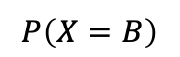
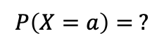
Probability vs. Probability Density
Probability Density
Function (PDF)
Probability
X=A
X=B
X=C
X=D
X=a
$$P\left(X=B\right)$$
$$P\left(X=a\right)= ?$$

Slide 9
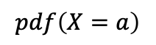
Probability vs. Probability Density
Probability Density
Function (PDF)
Probability
X=A
X=B
X=C
X=D
X=a
Does NOT exist!
$$P\left(X=B\right)$$
$$P\left(X=a\right)= ?$$
$$pdf\left(X=a\right)$$

Slide 10
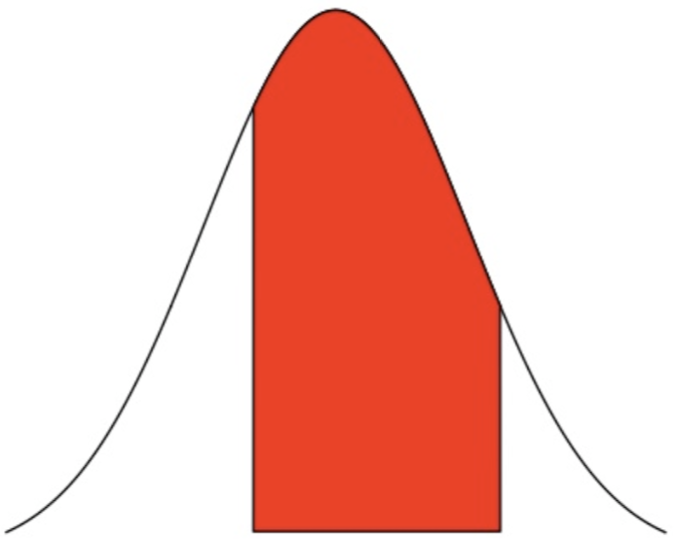
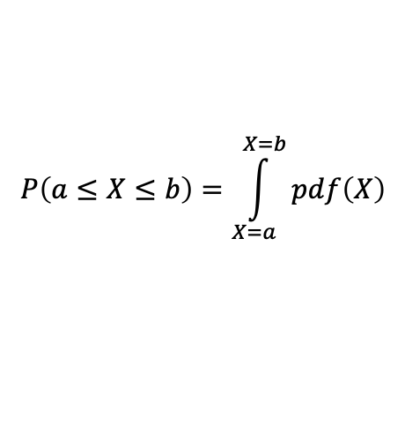
Probability vs. Probability Density
Probability Density
Function (PDF)
Probability
X=A
X=B
X=C
X=D
X=a
X=b
$$P\left(a≤X≤b\right)=\int_{X=a}^{X=b}{pdf\left(X\right)}$$
$$P\left(X=B\right)$$

Slide 11
Cumulative Density Function (CDF)

Slide 12
Survival Function
SF(x=1)
CDF(x=1)

Slide 13
Learning goals – Probability density
You will understand the difference between a probability and a probability density.

Slide 14
Learning goals – Descriptive statistics
mean and variance

Slide 15
Some common statistics of distributions
mean
variance (standard deviation)
median
mode
skewness
kurtosis

Slide 16
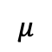
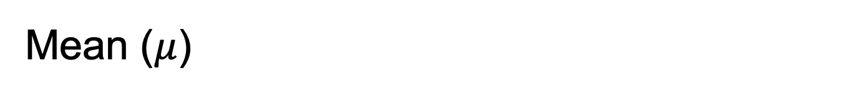
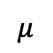
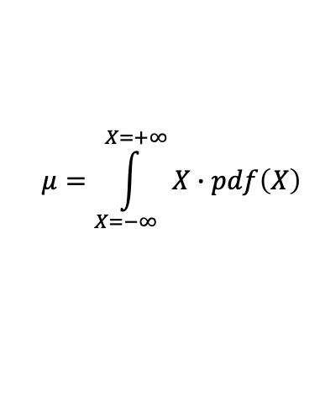
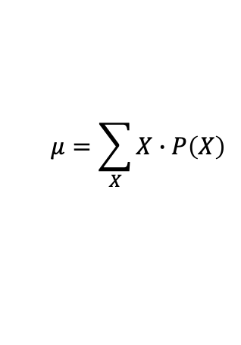
Mean ($μ$)
$$μ$$
$$μ$$
Probability Density
Function (PDF)
Probability
X=A
X=B
X=C
X=D
X
$$μ=\sum_{X}{X∙P\left(X\right)}$$
$$μ=\int_{X=−∞}^{X=+∞}{X∙pdf\left(X\right)}$$

Slide 17
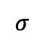
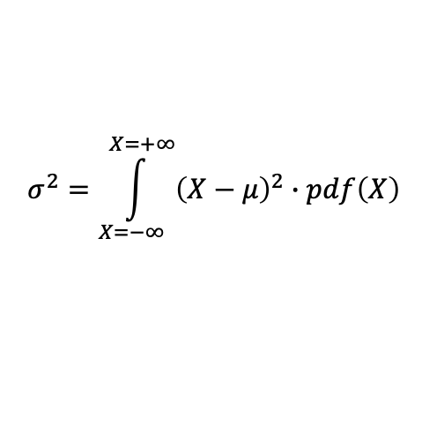
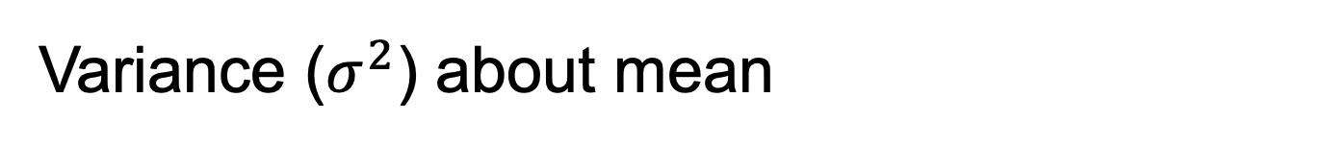
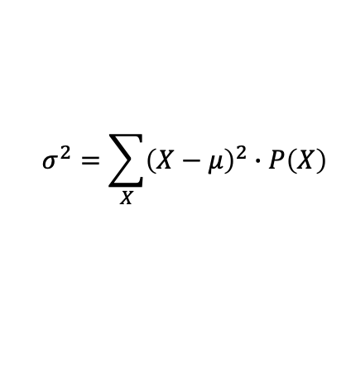
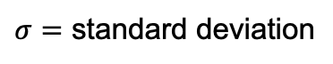
Variance ($σ^{2}$) about mean
$$μ$$
$$μ$$
$$σ$$
Probability Density
Function (PDF)
$σ=$ standard deviation
Probability
X=A
X=B
X=C
X=D
X
$$σ^{2}=\sum_{X}{{\left(X−μ\right)}^{2}∙P\left(X\right)}$$
$$σ^{2}=\int_{X=−∞}^{X=+∞}{{\left(X−μ\right)}^{2}∙pdf\left(X\right)}$$

Slide 18
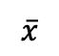
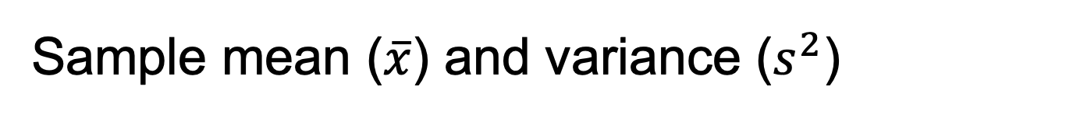
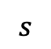
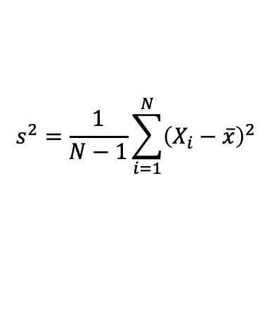
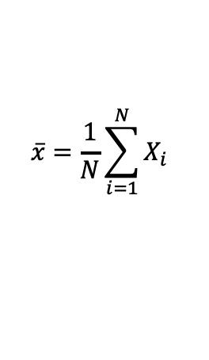
Sample mean ($\overline{x}$) and variance ($s^{2}$)
$$\overline{x}$$
# of Observations
$$s$$
X
$$\overline{x}=\frac{1}{N}\sum_{i=1}^{N}{X_{i}}$$
$$s^{2}=\frac{1}{N−1}\sum_{i=1}^{N}{{\left(X_{i}−\overline{x}\right)}^{2}}$$

Slide 19
Learning goals – Descriptive statistics
mean and variance

Slide 20
Learning goals – Probability distributions
You will understand how four basic probability distributions (normal, exponential, poisson, binomial) relate to particular types of random behavior.

Slide 21
Four probability distributions you should know
Normal
Exponential
Poisson
Binomial

Slide 22
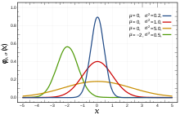
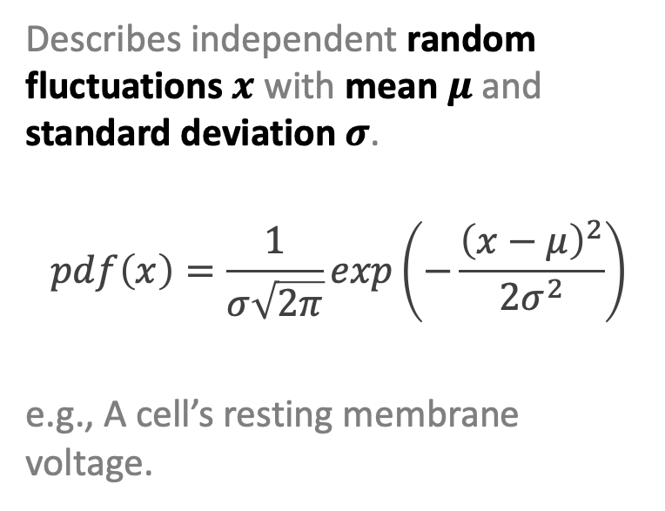
Normal Distribution random fluctuations
Describes independent random fluctuations $x$ with mean $μ$ and standard deviation $σ$.
$$pdf\left(x\right)=\frac{1}{σ\sqrt{2π}}exp\left(−\frac{{\left(x−μ\right)}^{2}}{2σ^{2}}\right)$$
e.g., A cell’s resting membrane voltage.

Slide 23
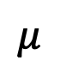
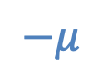
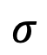
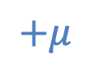
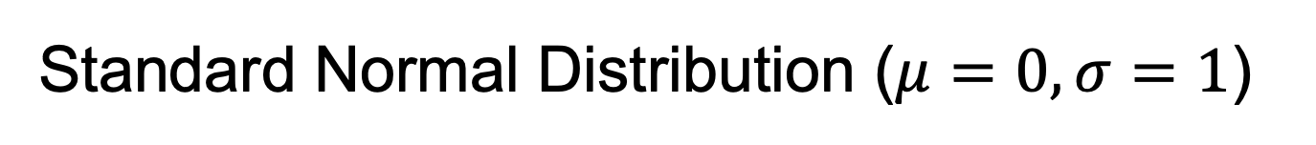
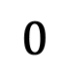
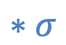

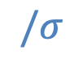

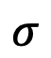
Standard Normal Distribution ($μ=0,σ=1$)
$$−μ$$
$$/σ$$
$$σ$$
$$σ$$
$$1$$
$$+μ$$
$$∗σ$$
$$μ$$
$$0$$
$$0$$

Slide 24
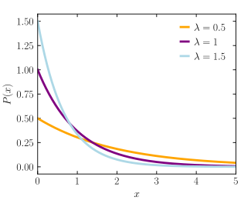
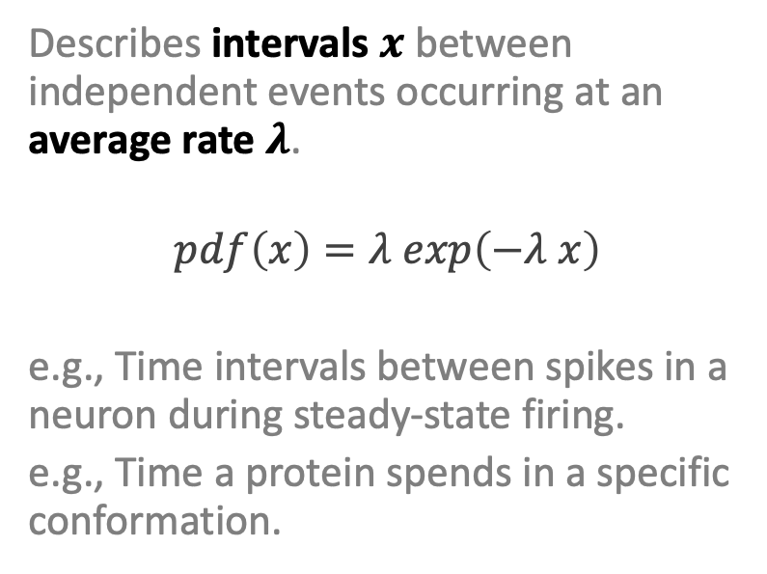
Exponential Distribution event intervals (constant average rate)
Describes intervals $x$ between independent events occurring at an average rate $λ$.
$$pdf\left(x\right)=λ exp\left(−λ x\right)$$
e.g., Time intervals between spikes in a neuron during steady-state firing.
e.g., Time a protein spends in a specific conformation.

Slide 25
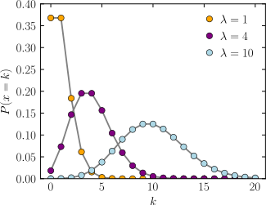
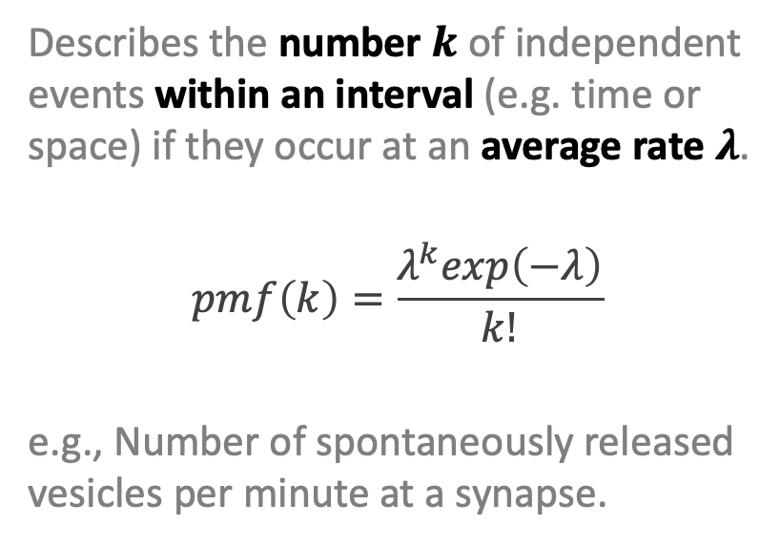
Poisson Distribution # events per interval (constant average rate)
Describes the number $k$ of independent events within an interval (e.g. time or space) if they occur at an average rate $λ$.
$$pmf\left(k\right)=\frac{λ^{k}exp\left(−λ\right)}{k!}$$
e.g., Number of spontaneously released vesicles per minute at a synapse.

Slide 26
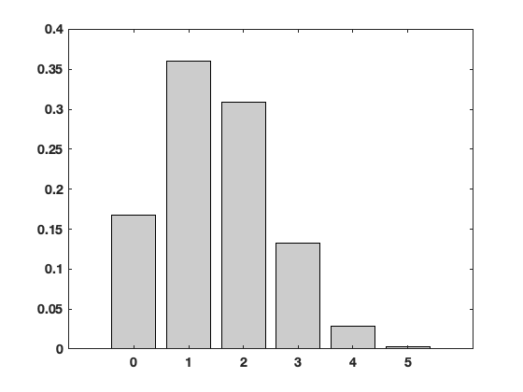
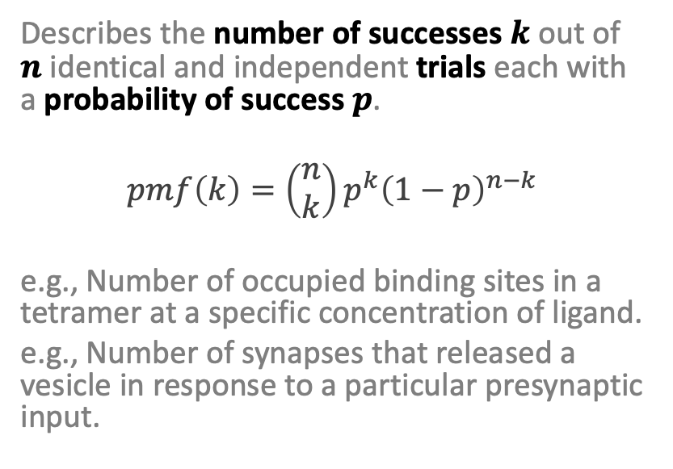
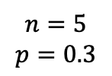
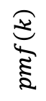
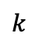
Binomial Distribution how many (yes/no) out of the total number?
Describes the number of successes $k$ out of $n$ identical and independent trials each with a probability of success $p$.
$$pmf\left(k\right)=\left(\begin{matrix}n \\ k\end{matrix}\right)p^{k}{\left(1−p\right)}^{n−k}$$
e.g., Number of occupied binding sites in a tetramer at a specific concentration of ligand.
e.g., Number of synapses that released a vesicle in response to a particular presynaptic input.
$$n=5$$
$$p=0.3$$
$$pmf\left(k\right)$$
$$k$$

Slide 27
Learning goals – Probability distributions
You will understand how four basic probability distributions (normal, exponential, poisson, binomial) relate to particular types of random behavior.

Slide 28
What’s so great about using a probability distribution to describe your data?
The entire data distribution is described by a small number of meaningful parameters.
This makes for a very simple data model that is easy to use and easy to interpret.
If your data is well described by a simple probability distribution, then this is most likely what you want to use.

Slide 29
Learning goals – Sampling distribution
You will understand what a sampling distribution is.
You will understand the Central Limit Theorem.
You will appreciate how the Central Limit Theorem explains why normal-ish distributions are frequently observed in biological measurements.

Slide 30
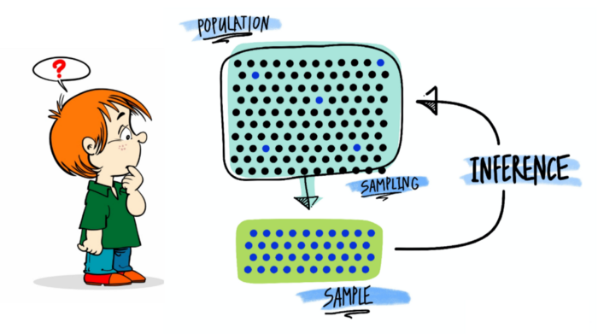
Sampling and statistical inference

Slide 31
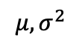
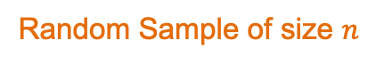
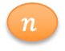


Population vs. Sample
Population
$$μ, σ^{2}$$
$$n$$
$$\overline{x},s^{2}$$
Random Sample of size $n$
$$n$$

Slide 32
















Sampling Distribution
Population
$$μ, σ^{2}$$
$$n$$
$$n$$
$$n$$
$${\overline{x}}_{1},s_{1}^{2}$$
$$n$$
$$n$$
$$n$$
$$n$$
$${\overline{x}}_{2},s_{2}^{2}$$
Distribution of sample means
$$n$$
$$n$$
$$n$$
$${\overline{x}}_{3},s_{3}^{2}$$
$$n$$
…
PDF
$${\overline{x}}_{1}$$
$${\overline{x}}_{2}$$
$${\overline{x}}_{3}$$
$$\overline{x}$$

Slide 33



Central Limit Theorem
For large enough sample size (typically $n≥30$), the distribution of sample means will tend towards a normal distribution about the population mean $μ$ with variance ${σ^{2}}/n$
Population
$$μ, σ^{2}$$
$$n$$
$$n$$
$$n$$
$${\overline{x}}_{1},s_{1}^{2}$$
$$n$$
$$n$$
$$n$$
$$n$$
$${\overline{x}}_{2},s_{2}^{2}$$
$$n$$
$$n$$
$$μ$$
$$n$$
$${\overline{x}}_{3},s_{3}^{2}$$
$$n$$
…
$$\frac{σ}{\sqrt{n}}$$
PDF
$${\overline{x}}_{1}$$
$${\overline{x}}_{2}$$
$${\overline{x}}_{3}$$
$$\overline{x}$$

Slide 34




Central Limit Theorem
For large enough sample size (typically $n≥30$), the distribution of sample means will tend towards a normal distribution about the population mean $μ$ with variance ${σ^{2}}/n$
Population
$$μ, σ^{2}$$
$$n$$
$$n$$
$$n$$
$${\overline{x}}_{1},s_{1}^{2}$$
$$n$$
$$n$$
$$n$$
$$n$$
$${\overline{x}}_{2},s_{2}^{2}$$
$$n$$
$$n$$
$$μ$$
$$n$$
$${\overline{x}}_{3},s_{3}^{2}$$
$$n$$
…
$$\frac{σ}{\sqrt{n}}$$
$$μ$$
PDF
$$σ$$
PDF
The population distribution can be almost anything and this still holds true!
$${\overline{x}}_{1}$$
$${\overline{x}}_{2}$$
$${\overline{x}}_{3}$$
$$\overline{x}$$
Population $x$

Slide 35
Normal-ish distributions are everywhere
Consider a complicated biological processes where the parameter that you measure results from the sum of multiple underlying processes.
By the central limit theorem, we might expect our measurements to have a normal distribution even if the underlying processes do not.

Slide 36
Learning goals – Sampling distribution
You will understand what a sampling distribution is.
You will understand the Central Limit Theorem.
You will appreciate how the Central Limit Theorem explains why normal-ish distributions are frequently observed in biological measurements.

